Slide 1
Regolith Linux
i3 For Those Who Don’t Have Time For i3

Slide 2
What is it?
“Regolith is a modern desktop environment designed to let you work faster by reducing unnecessary clutter and ceremony. Built on top of Ubuntu, GNOME, and i3, Regolith stands on a well-supported and consistent foundation.”

Slide 3
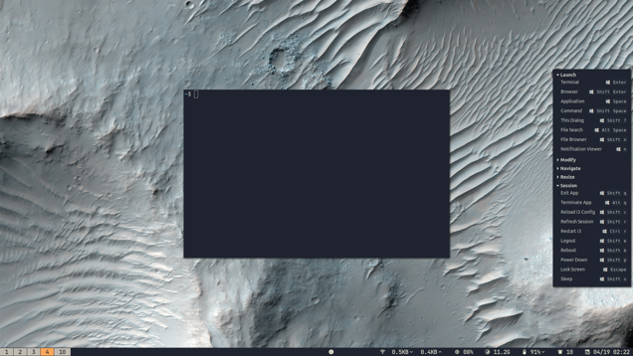

Slide 4
Distro vs. DE
Can be downloaded as a distro
Can be put on top of an Ubuntu-based distro
Uses GNOME’s management
Uses Ubuntu’s app store

Slide 5
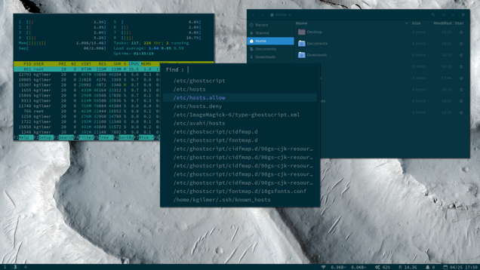
Regolith-look

